Slide 1
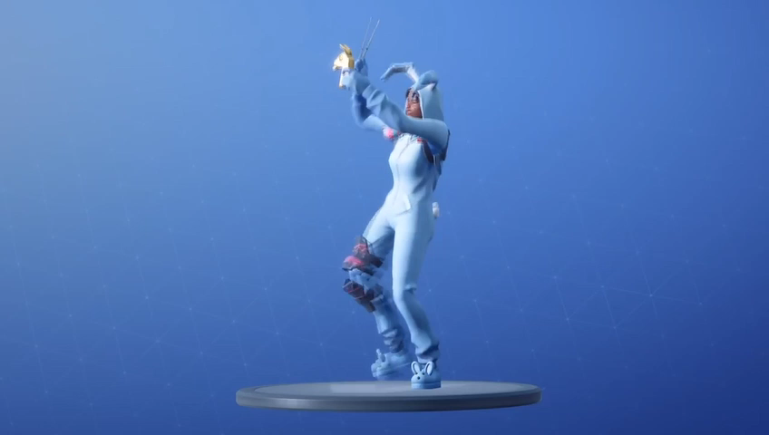
Fighting fake news in real life video streams
Gen Z – Future of TV – Hackathon
Team LLAMA Bell
Team members:
Pini Faran
Inna Trava
Arik De-Mayo
Assaf Avital
Amit Zvik
* LLAMA Bell is one of the most popular dances that can be purchased in Fortnite

Slide 2
Fighting fake news in real life video streams
Why Gen Z?
Because they are Always On
They consume content on YouTube and Instagram
Because they looks to serve, share, and impact
Future of News TV
Consumed as short video stream
Anyone can be a news reporter
News will be generated and shared from the field
Opportunity for monetization
Safe news channel (paid)
Sell credibility rank
Media channels
Individuals
Increase customer loyalty
New joint offering for UXP, Vindicia and Vubiquity
Technology innovation & Visionary company

Slide 3

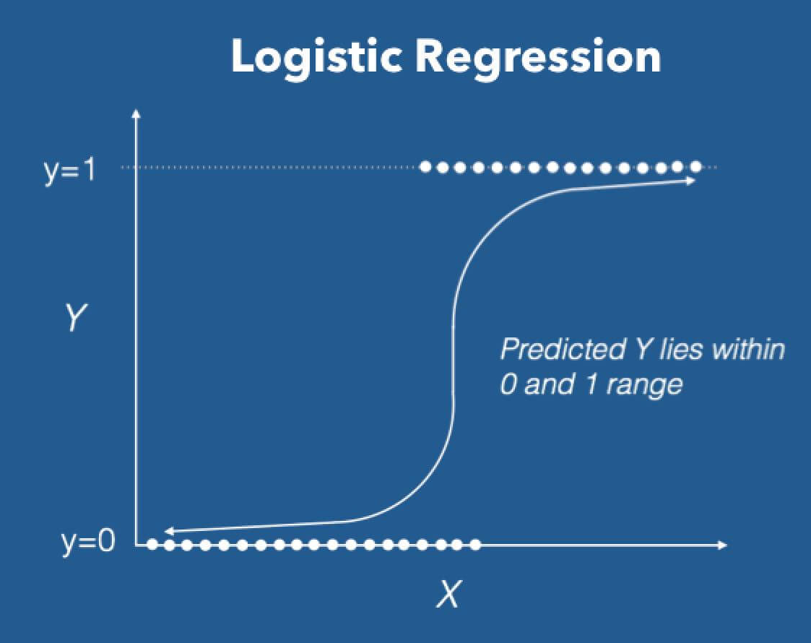

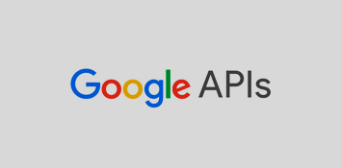









How it Works
Web Sites Ranking
Search Key Words on Web
Openscoring;
Logistic regression model
Audio Transcription
Extract Key Words
White/Black List
Notify User
Machine Learning based Decisioning
Open Source speech recognition toolkit
Free machine learning library for the Python
Search Key Words on Vubiquity
Notify Community
Feedback for Machine Learning Training
Analyze Key Words Using NLP

Slide 4

Fighting fake news in real life video streams

Slide 5
Backup Slides

Slide 6
Fighting fake news in real life video streams
Why Gen Z?
Gen Z is the Always On generation, they spend 76% of their time online
Gen Z Favorite Channels are YouTube and Instagram
Gen Z love to be part of communities, they looks to serve, share, and impact
Gen Z doesn’t care about who the service provider is
Future of News TV
Consumed as short video stream
Anyone can be a news reporter
News will be generated and shared from the field
Opportunity for monetization
For media providers
Safe news channel (paid)
For the media & service provider
Sell credibility rank to media channels and to individuals
Increase customer loyalty
For amdocs
New joint offering for UXP, Vindicia and Vubiquity
Technology innovation & Visionary company

Slide 7
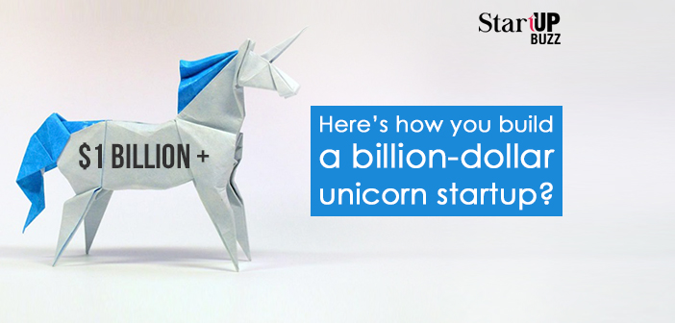

Potential Impact & Monetization
New startup
Offer “fake news free” certification to media channels
Offer “fake news fighter” certificate to individuals
Establish a “safe news” channel
For media providers
Establish a safe news channel in which every one can be news reporters from the field
For the media & service provider
Sell credibility rank to media channels and to individuals
Gains recognition from Gen Z
Positioned as partner for Gen Z
Positioned as an active contributor to the community
For amdocs
New joint offering for UXP, Vindicia and Vubiquity
New offering for amdocs media
Technology innovation
Visionary company
Contributor to a better world

Slide 8
Feasibility check & Future improvements
E2E system presented in the live demo
Many researches were published about fake news detection
Research proves that machine learning based algorithms can detect fake new better then human beings
No mature automatic tools exist in the market
Future technology improvements
Leverage edge computing
Further improvements of the speech to text engine
Further improvements of key words extraction
Future capabilities
Use additional data for fake news detection such as location, reporter/publisher, etc.

Slide 9
Compatibility with Generation Z
Gen Z is the Always On generation, they spend 76% of their time online
Gen Z Favorite Channels are YouTube and Instagram
Gen Z love to be part of communities, they looks to serve, share, and impact
Gen Z expects awesome experience
They may purchase new devices if their experience deteriorates
Gen Z doesn’t care about who the service provider is

Slide 10
About Fake News & Deepfake
4 Tips for Spotting a Fake News Story: https://www.summer.harvard.edu/inside-summer/4-tips-spotting-fake-news-story
Tips to Spot False News: https://www.facebook.com/help/188118808357379
Fake news: Universities offer tips on how to spot it: https://www.bbc.com/news/education-41902914
How to spot fake news in your social media feed: https://www.nbcnews.com/better/news/can-you-spot-fake-news-your-feed-ncna854036
Google News Initiative announced to fight fake news and support journalism: https://www.theverge.com/2018/3/20/17142788/google-news-initiative-fake-news-journalist-subscriptions
DeepFake (Deep Learning & Fake News) Videos
https://www.youtube.com/watch?v=gLoI9hAX9dw
TED Talk: https://www.youtube.com/watch?v=o2DDU4g0PRo
Deepfake Wikipedia: https://en.wikipedia.org/wiki/Deepfake

Slide 11
Fighting fake news in real life video streams
amdocs Fake News Detector (aFND)
Fake News Fighter's Community
Monetization
A mechanism for automatic detection of fake news in real life video streams using content analysis and machine learning
Win credits for active participance in fake news fighting activities
Gain more credits for becoming a top rated Fake News Fighter
Become a provider of News Channel
Selling creditability ranks
For media channels
For individuals
Increase customer loyalty
Gain recognition from Gen Z

